Slide 1
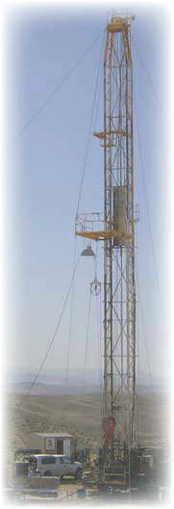
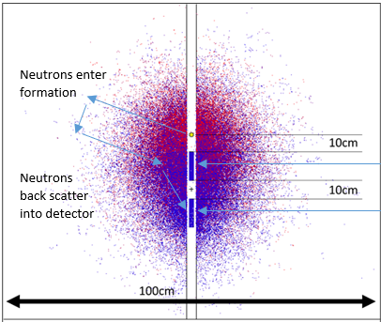
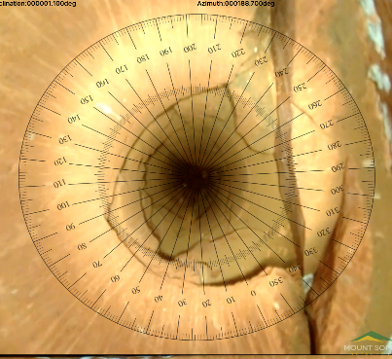
Recent Advances in Borehole Geophysical Logging Tools for Groundwater Applications
Notes:
For many decades now, the groundwater community has used borehole geophysical logging techniques to characterize aquifers and identify permeable / hydraulically important zones intersecting the borehole wall. Municipalities, water conservation districts, individual homeowner’s and numerous other entities contract logging service companies or consultants to geophysically log wells to determine location, thickness, transmissivity, and quality of primary permeability aquifers and fractured rock or secondary permeability zones. Geophysical logs are used for petrophysical properties logging, rock-typing, etc. In the groundwater industry, in-situ estimates of porosity are useful. With that in mind today, I am going to discuss two downhole tools that help us estimate porosity, borehole magnetic resonance (BMR), and a recently developed non-chemical source neutron generator tool. I will also describe a few advances in digital video surveying developed for the groundwater marketplace.

Slide 2
Why Use Borehole Logging
Calibrated and Objective
Continuous Repeatable Profile
Numerous Parameters Available
Rock & Fluid Properties In-situ
Immediate Results for Analysis
Easily Archived for Future Reference
Notes:
Calibrated and Objective
On site calibrations, often traced to international standard.
Continuous Repeatable Profile
Numerous Parameters Available
In the GW industry, numerous downhole parameters readily available
Rock & Fluid Properties In-situ
Semi-quantitative petrophysical properties
Immediate Results for Analysis
Easily Archived for Future Reference

Slide 3
Groundwater Logging
Natural Gamma (delineate hydrostratigraphic units)
Spontaneous Potential (SP)
Resistivity (normal, single point, lateral, multi-point)
Flow Meter (ambient and pumping cond.)
Caliper (calculate cement volume)
Full Waveform Sonic (CBL)
Deviation (submersible pumps)
Temperature / Fluid Conductivity
Notes:
Some of the commonly used geophysical logs in the GW community include Gamma, including spectral gamma, SP, resistivity (which is useful and semi-quantitative when corrected for borehole conditions), flow meters, caliper, 3-arm and XY caliper for borehole volume studies, full waveform sonic (for cement bonding after well emplacement), and radioactive source tools; however, the use of radioactive source logs in ground water studies is not used often because of regulatory or liability issues, but this may change in the mid term as a new, non-chemical source downhole neutron generator is emerging in the groundwater landscape which I will describe a bit later in this presentation. Most of the time only gamma and resistivity logs are collected in the field in a typical water well setting, spinner flow meters are sometimes used in water production wells for interval-specific flow and contribution to total flow, but often running flowmeters requires pulling a submersible pump to lower the tool ($$). Heat pulse flow meters are generally used in very small flow situations, although some studies demonstrate the use of this tool in higher floe situations.

Slide 4
Groundwater Logging
Fluid Sampling
Water Quality (pH, TFR, DO, ReDox)
Density (not often used)
Neutron (New non-source technology to estimate porosity)
Borehole Magnetic Resonance (BMR)
Borehole Video (Inspection, Integrity, Confirmation)
Notes:
As mentioned, neutron and density logging is not commonly used in groundwater logging. NMR (or BMR as some like to call it) has emerged in the last decade or so to profile in-situ porosity….. Semi-quantitatively. Clay-bound, capillary, and free water components of total porosity are presented in real-time or near real time, along with calculations of hydraulic conductivity.
Before moving on with our discussion, lets look at a few field shots of borehole logging in GW applications.

Slide 5
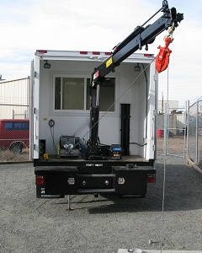
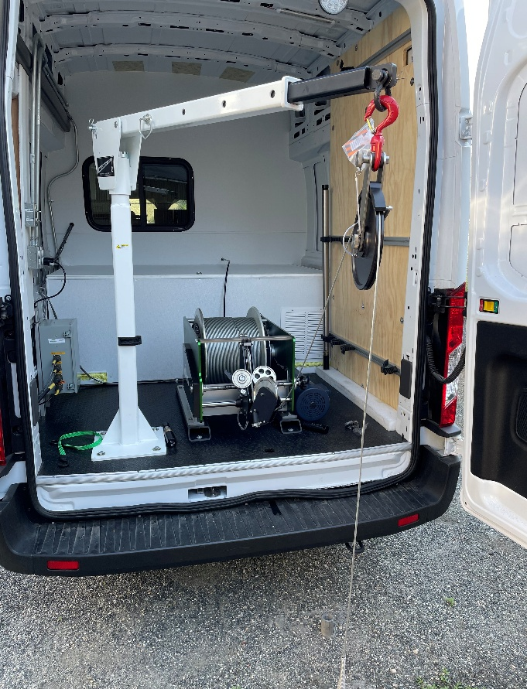
Groundwater Logging
Water Well Driller, MS
Deployed at Oyu Tolgoi Copper Mine, Mongolia
Notes:
F-550 Chassis truck used at a copper mine in Mongolia and a Ford Transit Van customized by a water well driller in MS.

Slide 6
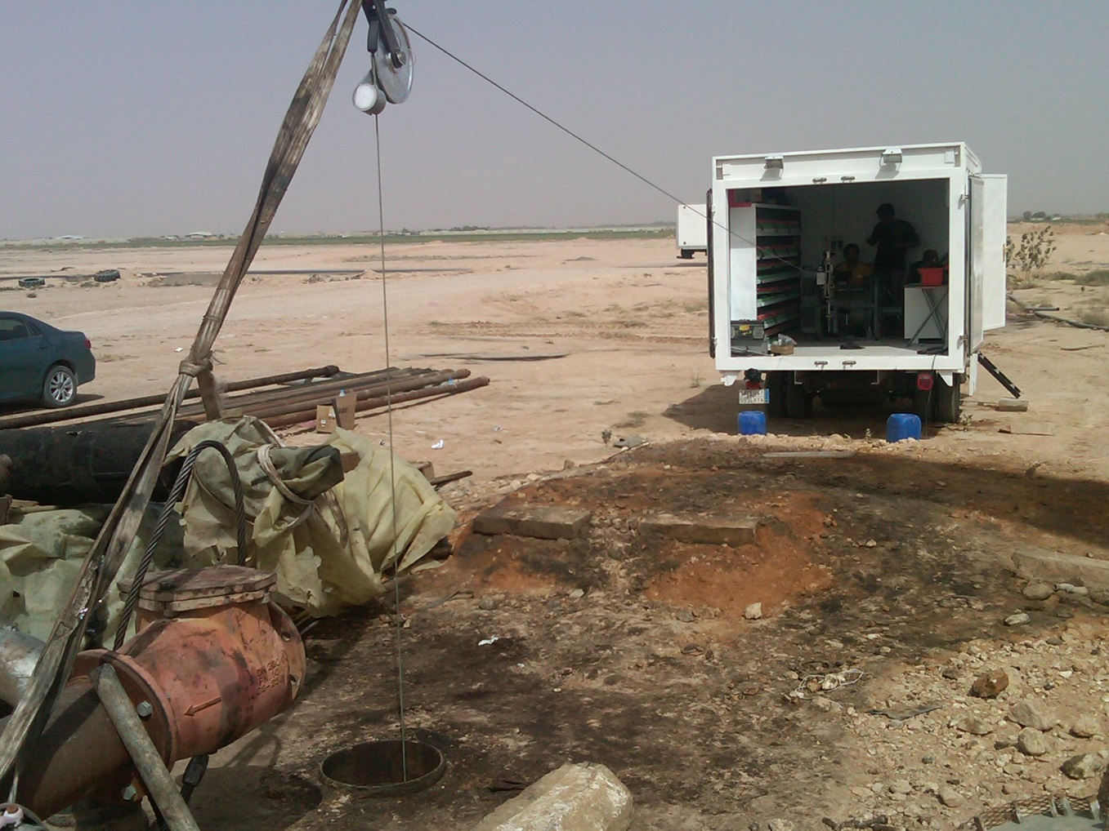
Groundwater Logging
Water Well site, Saudi Arabia
Static WL at this site = 1200 meters
Notes:
Static water table is around 1200 meters in Saudi Arabia. Age of water in some of these deep aquifers in Cretaceous.

Slide 7
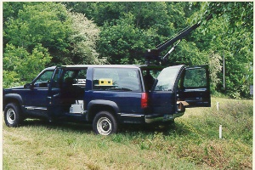
Water Well Logging
South Carolina Dept. of Health & Environmental Control
Notes:
Suburban with through-the-roof boom logging a PVC-cased monitoring well.

Slide 8
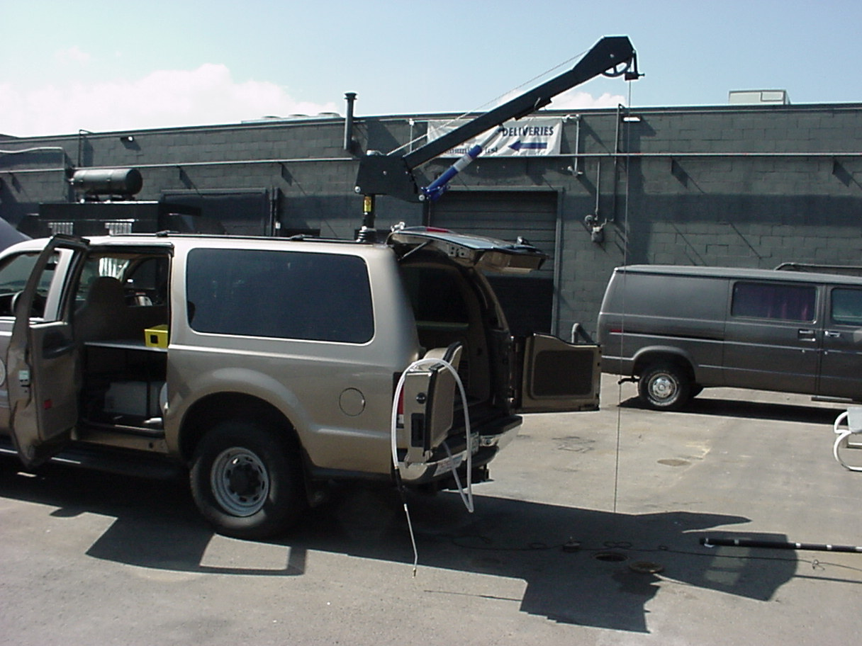
Water Well Logging
Illinois State Geological Survey
Notes:
Another SUV application equipped with all the basic tools for GW geophysical logging and CO2 sequestration studies in Southern IL.

Slide 9
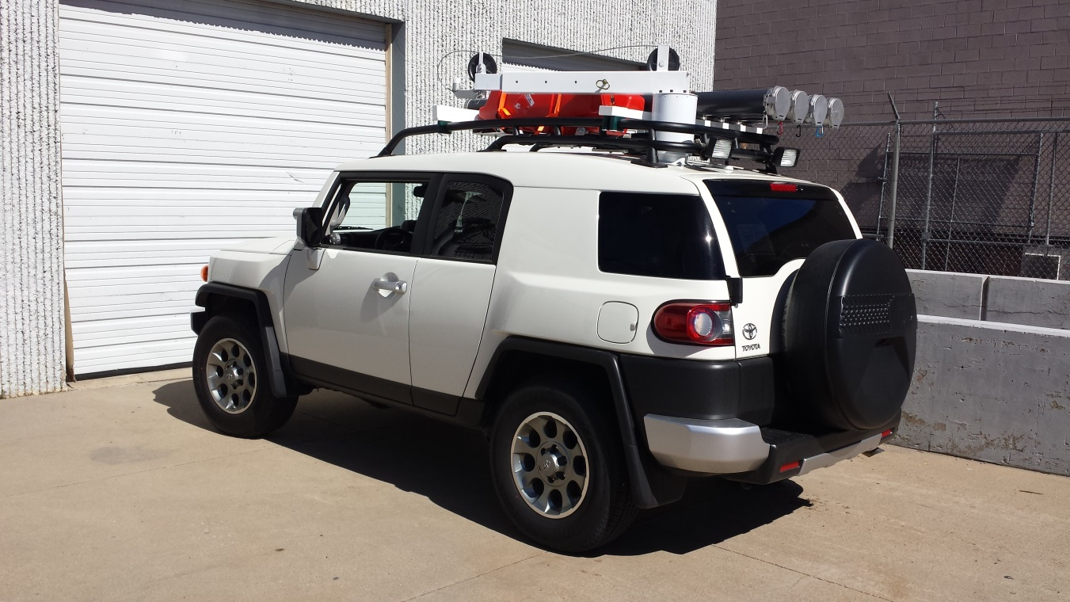
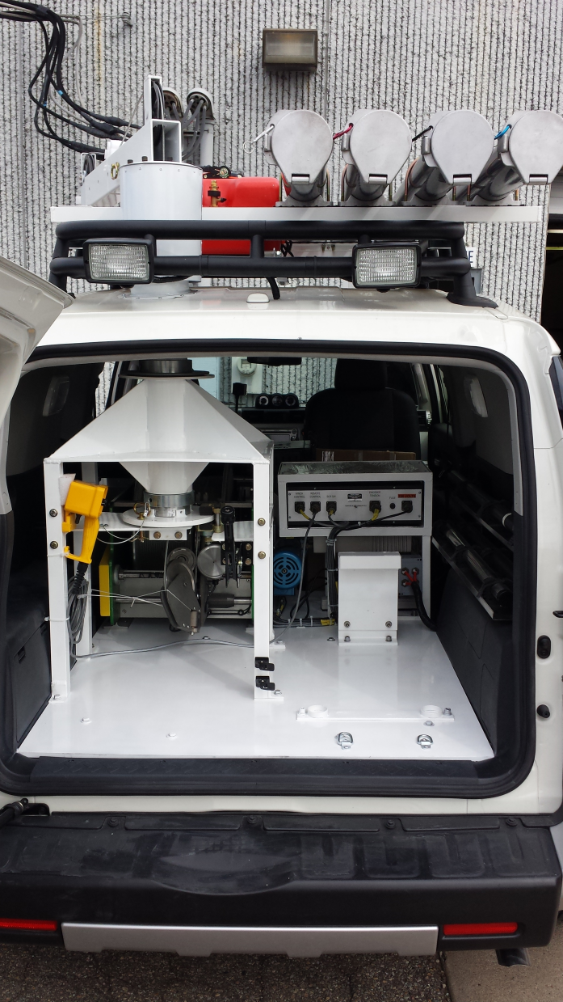
Groundwater Logging
Water Well Logging Truck sent to Algeria
Notes:
Smaller SUV’s with compact winches for deep aquifer water well logging in Northern Africa.

Slide 10
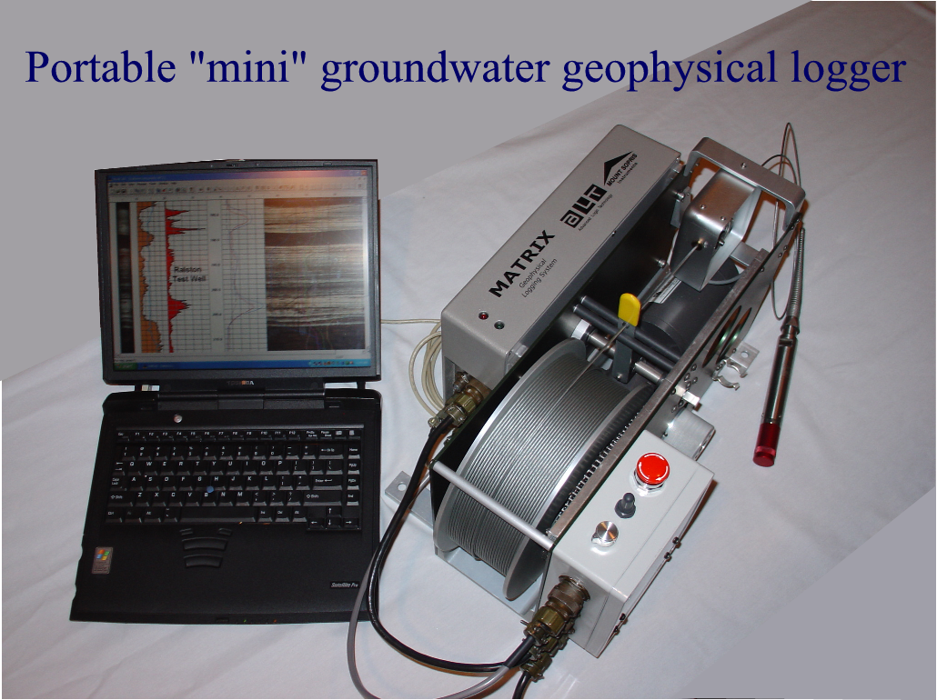
Groundwater Logging
Notes:
Mini-Loggers, have same basic capability as larger truck-mount systems, and are easy to rent for short term projects.

Slide 11
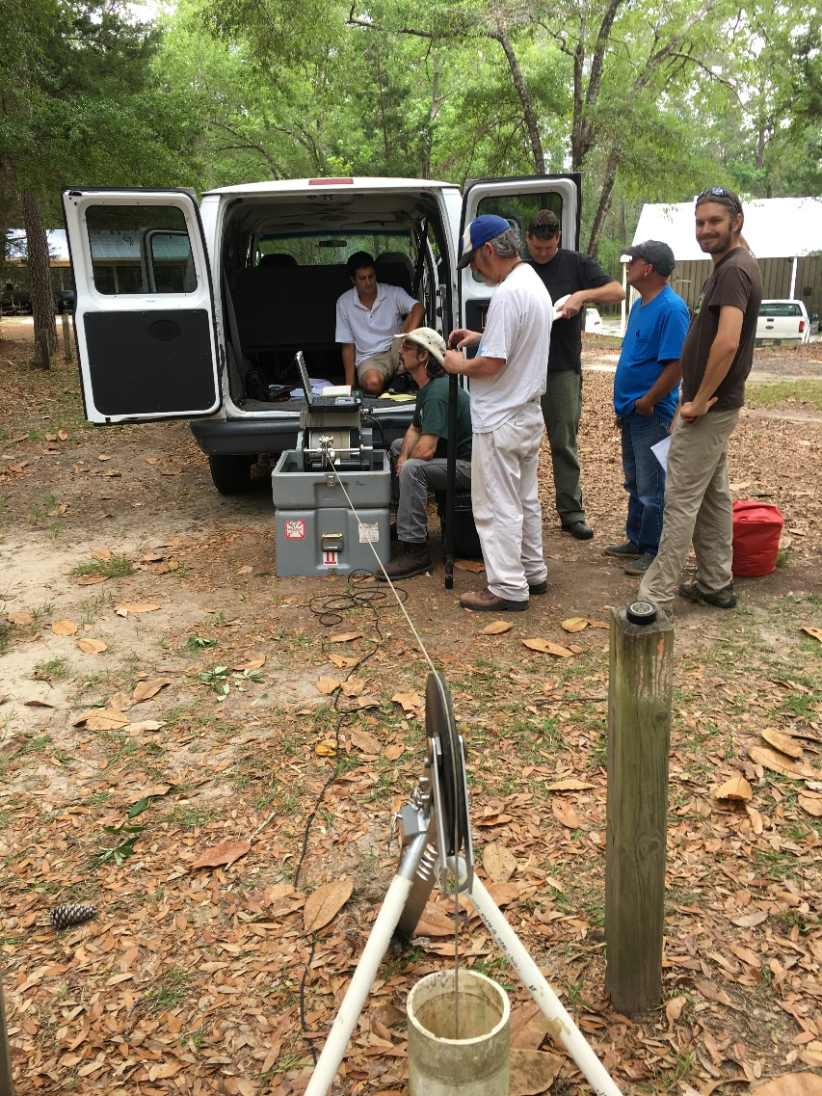
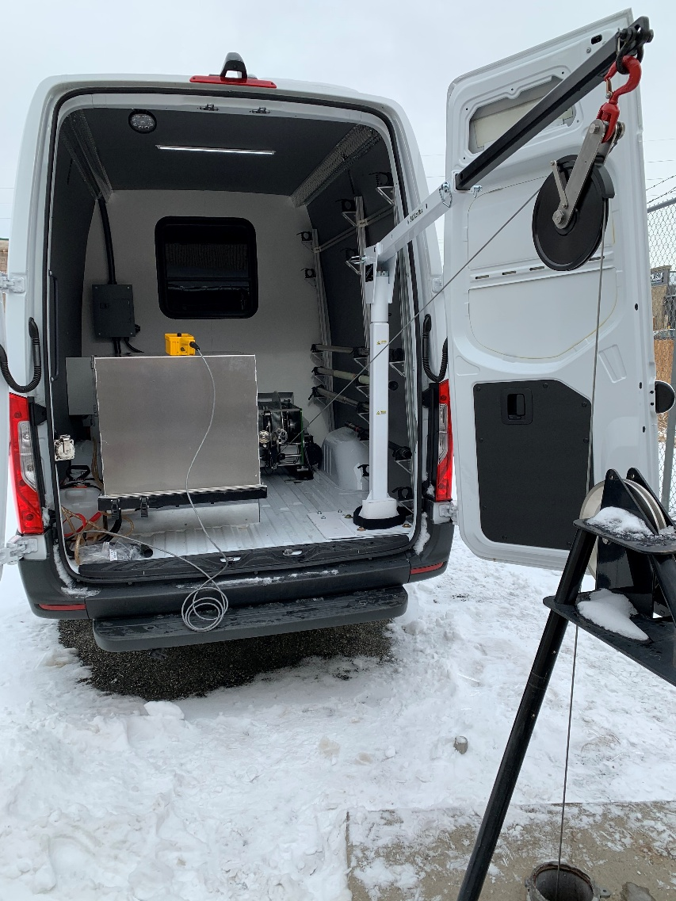
Groundwater Logging
FL Geological Survey, Tallahassee
SWFWMD District

Slide 12
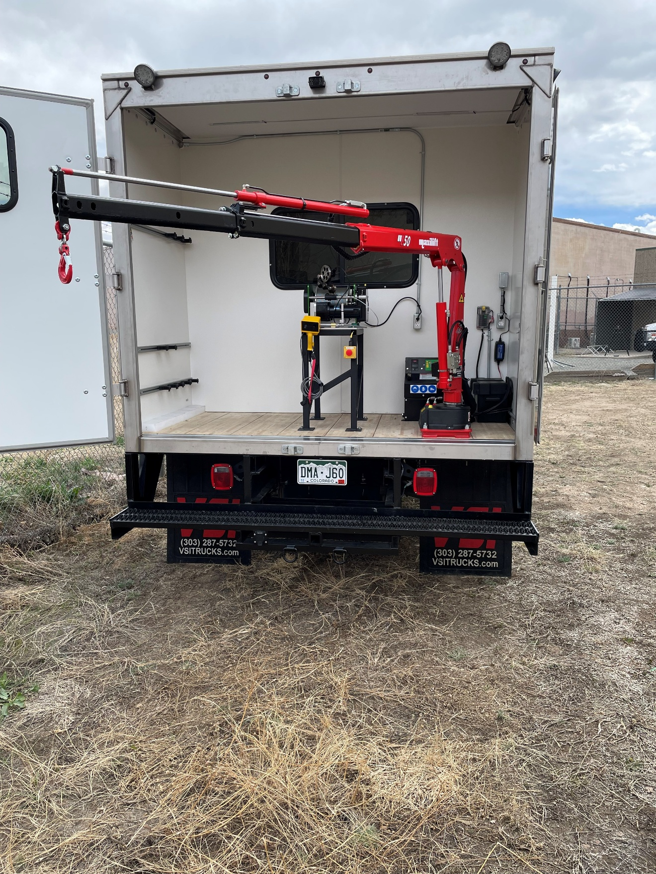

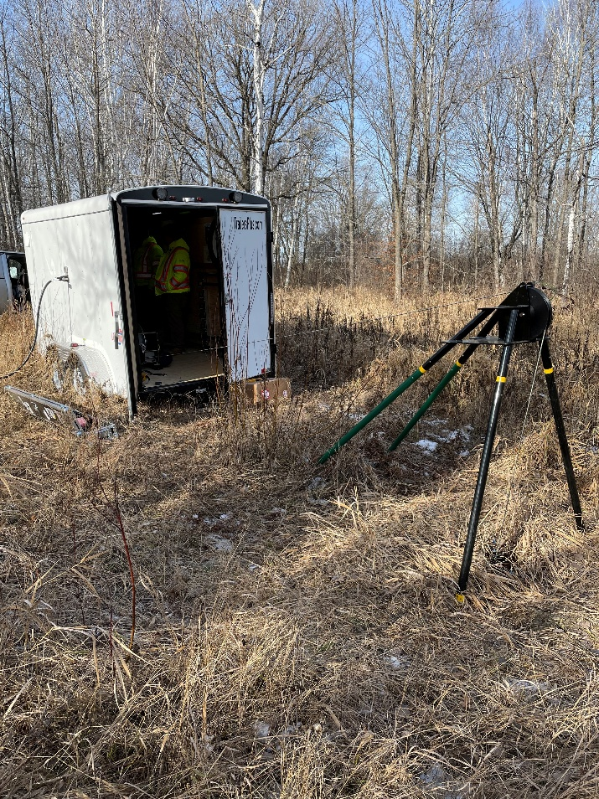
Groundwater Logging
Nuclear Power Plant, AL
Nickel Mine, Northern MN

Slide 13
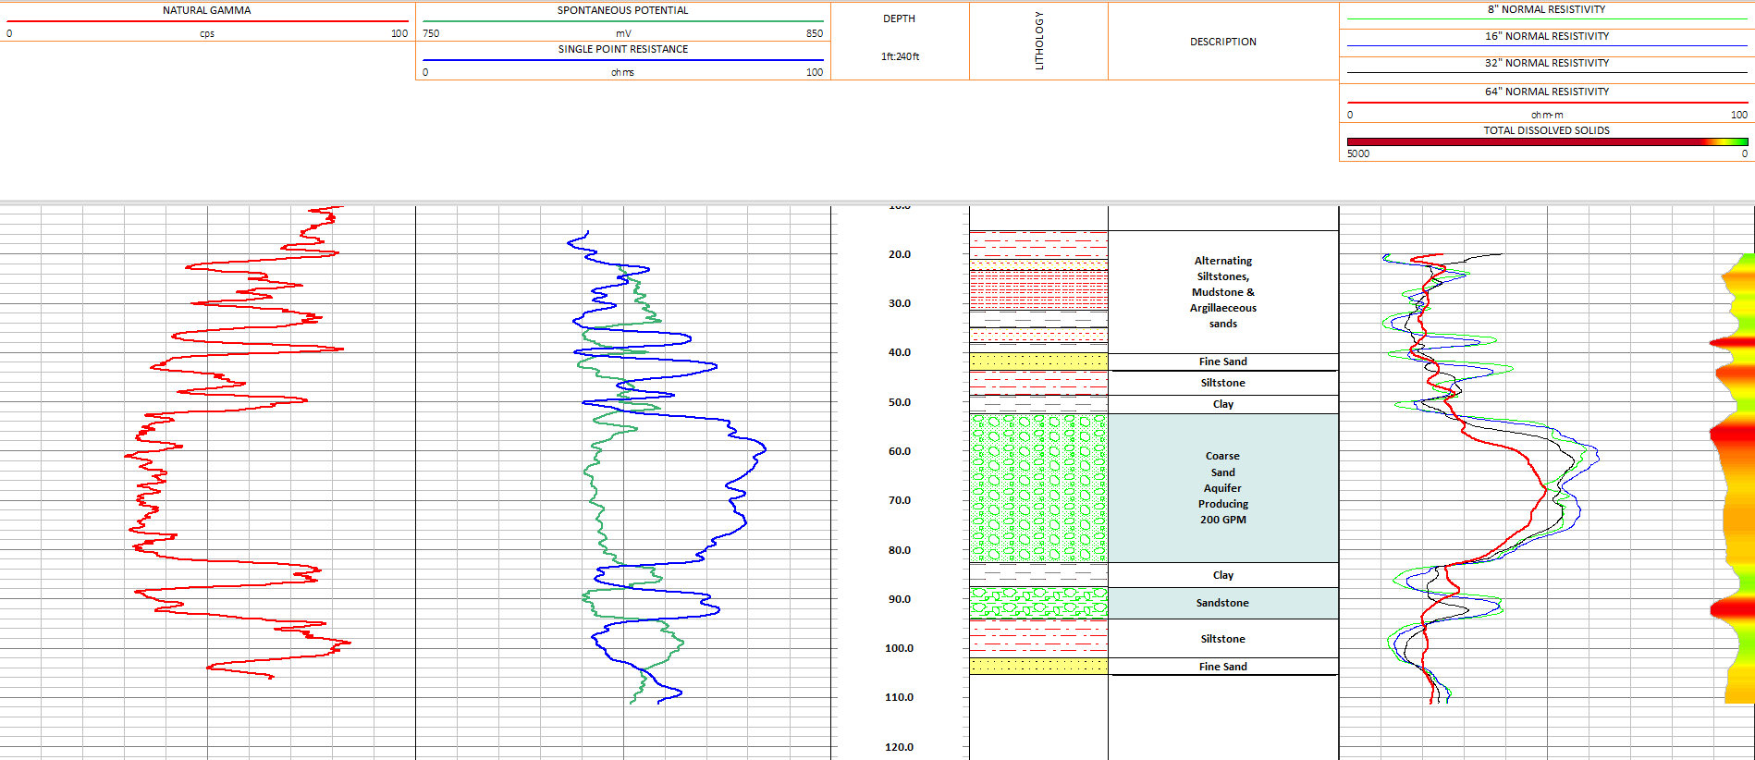
Typical Multi-Point GR-Resistivity Log
T=kb
Notes:
So, what does data look like coming from these logging platforms nowadays.
Since the mid-1990’s multi-point galvanic resistivity replaced historical “long & short” normal resistivity logging, allowing principal investigators, hydrogeologists, city water planners, and others to improve the characterization of shallow aquifers from geophysical logs. This typical groundwater well log includes natural gamma (red – Track 1), SP (green – Track 2), Single Point Resistance (blue – Track 2), Hydrogeologists often use the SPR log to get an accurate aquifer thickness and is often used for ‘b” in the Transmissivity equation, T = kb. 4-spacing resistivity – right track). Electrode spacing is typically 8-16-32-64 inches.
If the borehole fluid resistivity & temperature are known, total dissolved solids can be estimated (right side shading log).

Slide 14
Resistivity Log Calculations
Resistivity Logs → Estimate R_{w,t} and TDS
(Derived from Archie’s Equations)
R64 log
R8, R16 log
R_{w,t} = (R_{o,t} / R _{xo,t}) R _{mf,t}
TDS (mg/l) ≅ SC (uS/cm) x P
F = a * Φ^{m}
FR Log, FEC Log
Notes:
This water resistivity estimation method is based in part by the ratio of the fully saturated aquifer (R64 log) to the resistivity of the fully flushed zone (R8, R16) adjacent to the annulus in a mud-filled borehole as developed from Archie’s equations in 1942.
Porosity is generally determined by selecting a rock property that varies greatly between non-porous rock, and the formation water. If the response of a certain measurement is known for water, logs but for non-porous rock, then a relationship can generally be determined for estimating porosity from the measurement. This is commonly done with compensated gamma-gamma density logs, neutron logs, and sonic logs. The percent volume of clay in a rock can be estimated using a natural gamma log. Porosity indicated by these methods, along with clay volume, are sometimes used to calculate effective porosity. Fracture porosity and other types of secondary porosity are not usually indicated by these conventional geophysical logs but can de identified with imaging devices.
Archie’s Law can be used to estimate porosity when Rw and R₀ can be accurately determined. The general form of this relationship is,
F = Ro,t/Rw,t
F = a * Φ^{m}
where a is the cementation factor, φ is porosity, m is the cementation exponent, and F is the formation factor.
P = conversion constant dimension correlation factor in units of Siemens/cm, usually between 0.55 – 0.75 for ground water
Average error <25%
Advantage: knowledge of matrix properties such as porosity, cementation exponent, and volume clay not required
Accuracy is a function of mud, mud-filtrate & temperature measurements.

Slide 15
Typical Multi-Point GR-Resistivity Log
T=kb
Notes:
Going back to our typical water well log, within the aquifer from 53 to 83 feet, we see that resistivities merge in the lower portion vs the upper portion of the aquifer where we see separation, potentially indicating that the porosity and hydraulic conductivity vary vertically within the aquifer.

Slide 16
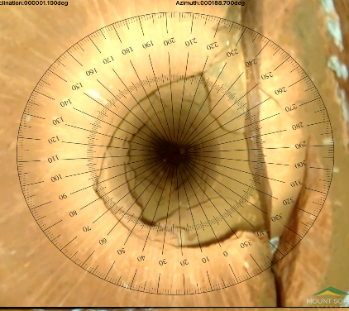
Recent Advances in Downhole Tools
Nuclear (Borehole) Magnetic Resonance
Neutron-Thermal-Neutron, non-chemical source
Borehole video Orientation Module with on-screen compass

Slide 17
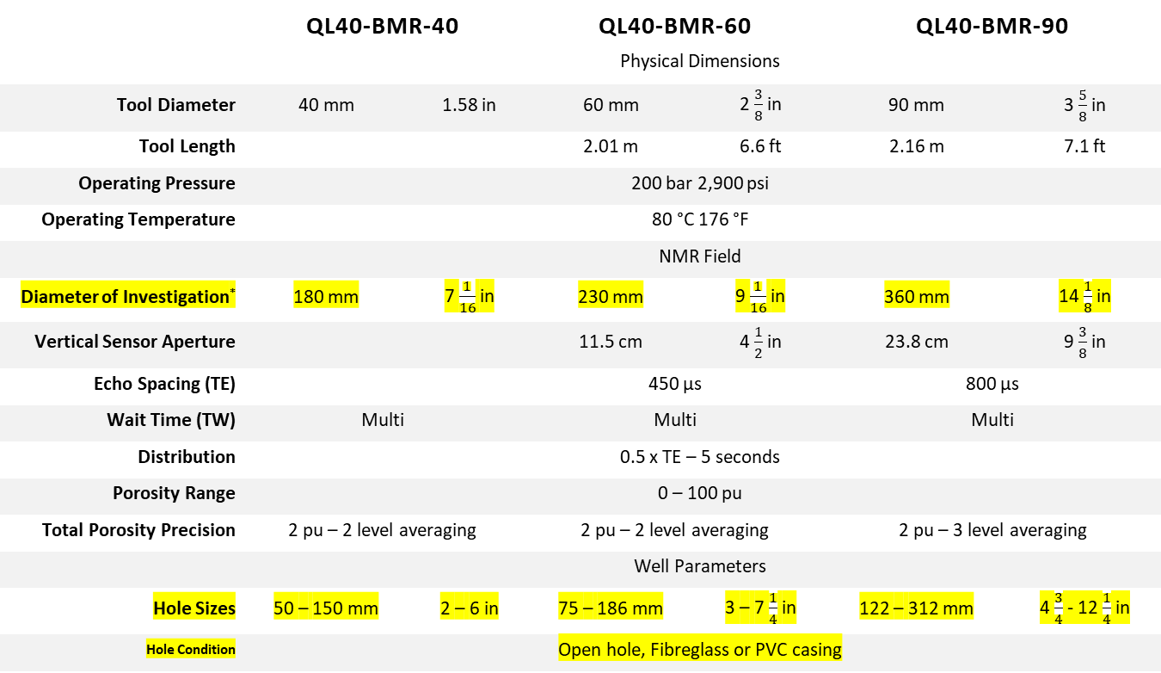
Nuclear (Borehole) Magnetic Resonance
 | QL40-BMR-40 |  | QL40-BMR-60 |  | QL40-BMR-90
 | Physical Dimensions
Tool Diameter | 40 mm | 1.58 in | 60 mm | 2 $\frac{3}{8}$ in | 90 mm | 3 $\frac{5}{8}$ in
Tool Length |  |  | 2.01 m | 6.6 ft | 2.16 m | 7.1 ft
Operating Pressure | 200 bar 2,900 psi
Operating Temperature | 80 °C 176 °F
 | NMR Field
Diameter of Investigation* | 180 mm | 7 $\frac{1}{16}$ in | 230 mm | 9 $\frac{1}{16}$ in | 360 mm | 14 $\frac{1}{8}$ in
Vertical Sensor Aperture |  |  | 11.5 cm | 4 $\frac{1}{2}$ in | 23.8 cm | 9 $\frac{3}{8}$ in
Echo Spacing (TE) |  |  | 450 µs |  | 800 µs
Wait Time (TW) | Multi |  | Multi |  | Multi
Distribution | 0.5 x TE – 5 seconds
Porosity Range | 0 – 100 pu
Total Porosity Precision | 2 pu – 2 level averaging |  | 2 pu – 2 level averaging |  | 2 pu – 3 level averaging
 | Well Parameters
Hole Sizes | 50 – 150 mm | 2 – 6 in | 75 – 186 mm | 3 – 7 $\frac{1}{4}$ in | 122 – 312 mm | 4 $\frac{3}{4}$ - 12 $\frac{1}{4}$ in
Hole Condition | Open hole, Fibreglass or PVC casing
Notes:
Rather than go into the detailed theory of borehole magnetic resonance today (which would take more than the allowed and I am no expert, I am going to go though a few basics that are likely relevant to our discussion today. Tools are available in 3 different diameters based on required diameter of investigation (DOI). Note that the tool can be run in open holes and PVC cased wells.
Several BMR tools are available with varying DOI to suit most groundwater applications. Just recently the BMR90 DOI has been increased to about 16” I think.

Slide 18
Nuclear (Borehole) Magnetic Resonance
Measured Parameters Calculated Parameters
Total porosity Permeability (Hydraulic Conductivity)
Pore size distribution (PSD) Dry weight density (need bulk density)
Free water porosity (specific yield) Adsorbed and free gas content of coals
Capillary-bound porosity Multi-mineral modelling (with other log suites)
Clay-bound porosity Specific retention (capillary + clay bound porosity)
Notes:
Historical indirect methods of estimating porosity and hydraulic conductivity in hydrogeological investigations, as shown in the typical water well example, have been replaced over the last decade or so with a more direct measurement. BMR tools respond directly to pore volume, regardless of lithology. That’s an important aspect. Real time measurements include clay-bound porosity, capillary-bound porosity, free water porosity or specific yield, and total porosity. Calculated parameters important to the groundwater community include hydraulic conductivity and specific retention ….. sum of capillary & clay bound porosity.

Slide 19
Nuclear (Borehole) Magnetic Resonance
Shallow Sandstone Aquifer
Notes:
In this BMR example through a sandstone aquifer.
Track 1 is the natural gamma with clay shaded to the right and sand to the left.
Track 2 are the porosity components.
Track 3 is the NMR T2 distribution, which represents a pore size distribution (smallpores to the left, large pores to the right)
Track 4 are calculated Hydraulic Conductivity curves.
Raw BMR data is inverted to give a continuous T2 distribution readily interrogated to derive:
Total Porosity
Bound Fluid (specific retention)
Free Fluid (specific yield)
Permeability (hydraulic conductivity)

Slide 20
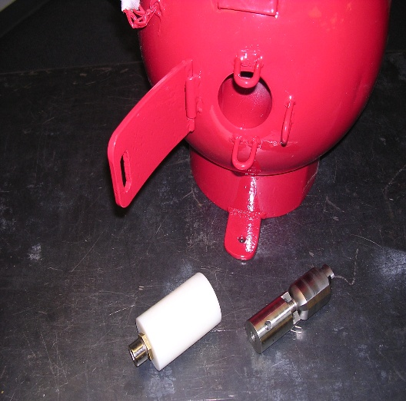
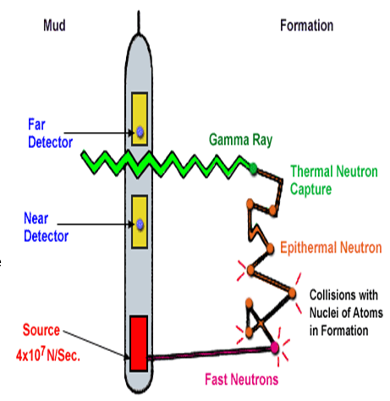
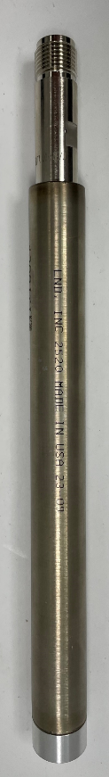
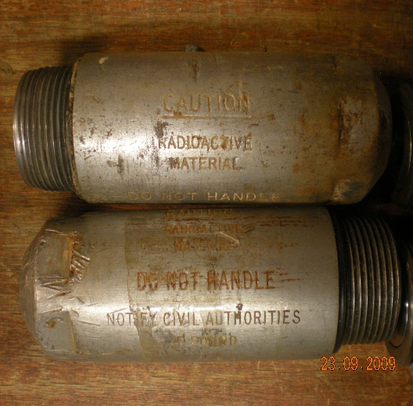
Typical Am₂₄₁Be Neutron-Thermal-Neutron Tool

Slide 21
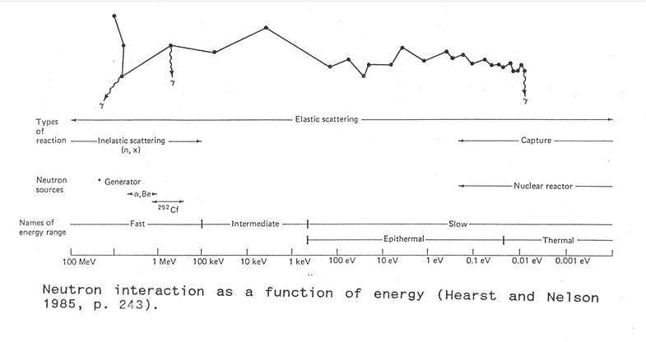
Typical Am₂₄₁Be Neutron-Thermal-Neutron Tool
Historical neutron tools: fast neutrons enter borehole formation from Am₂₄₁ Be or Cf₂₅₂ source and then thermalize (slow down) when they collied with pore water (hydrogen content capture x-section). Lower CPS at detector is proportional to higher porosity.
Notes:
Historical neutron tools: fast neutrons enter borehole formation from Am₂₄₁ Be or Cf₂₅₂ source and then thermalize (slow down) when they collied with pore water (hydrogen content capture x-section). Lower CPS at detector is proportional to higher porosity.

Slide 22
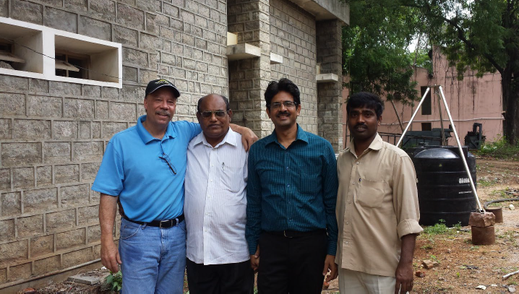
Calibrating Neutron tools
National Geophysical Research Institute, Hyderabad, India, 2016
Notes:
Calibrating neutron tools requires a 100% porosity end point. In this slide, the large tank in background full of water to represents 100% porosity. Two boreholes in the foreground of different diameter drilled through granite of 2% porosity yields the calibration curve in this slide. The D-D nGen is calibrated in a similar way, in tanks filled with media of known porosity.

Slide 23
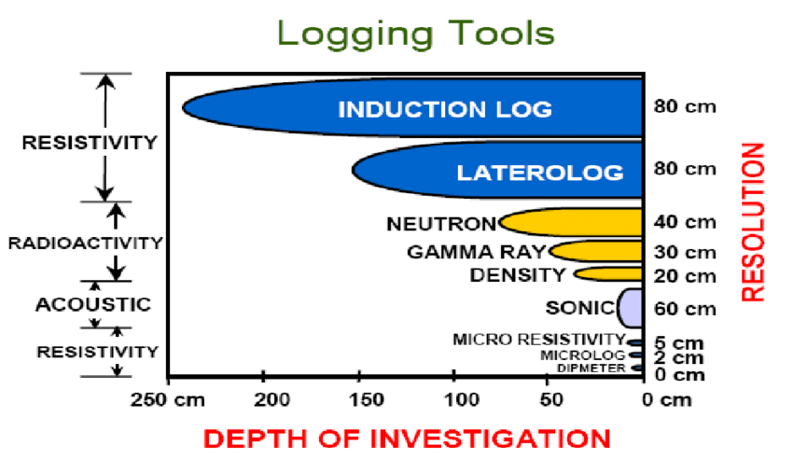
Neutron tool radius of investigation compared to other downhole logging tools.
BMR DOI is variable depending on tool geometry

Slide 24
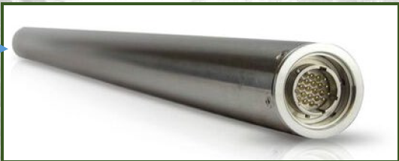
New D-D Neutron Generator
New slimline tool utilizes D-D neutron generation to provide a safer alternative to radioactive AmBe sources for well logging applications.
Notes:
Instead of using a radioactive source to generate fast neutrons, a new slimline tool utilizes a D-D reaction for neutron generation, providing a safer alternative to radioactive AmBe sources for well logging applications. Red line indicates radius of investigation for D-D tool. Note the much larger investigative radius for 14 MeV AmBe tool.

Slide 25
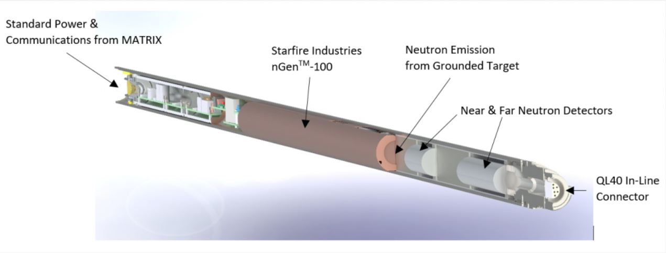
New Borehole Neutron Generator
2.45 MeV D-D fusion reaction neutron generation for direct replacement of Am-Be radiochemical sources used for neutron porosity logging in oil/gas, environmental, mining and water well characterization.
Operates on common geophysical wirelines. Stacks with other downhole tools. Reports neutron two channel neutron CPS. 50mm diameter.
Notes:
AmBe tools generate fast neutrons at much higher energy than D-D nGenerator pictured in this slide, so testing is going on at sites around the world to validate whether response is usable in groundwater settings.

Slide 26
MCNP Simulated nGen Response
Lithology can be mapped with neutron porosity and gamma density. Empirical correction factors, similar to those generated with Am-Be tools, can also be generated.
Notes:
Lithology can be mapped with neutron porosity and gamma density
Empirical correction factors, similar to those generated with Am-Be tools, can also be generated

Slide 27
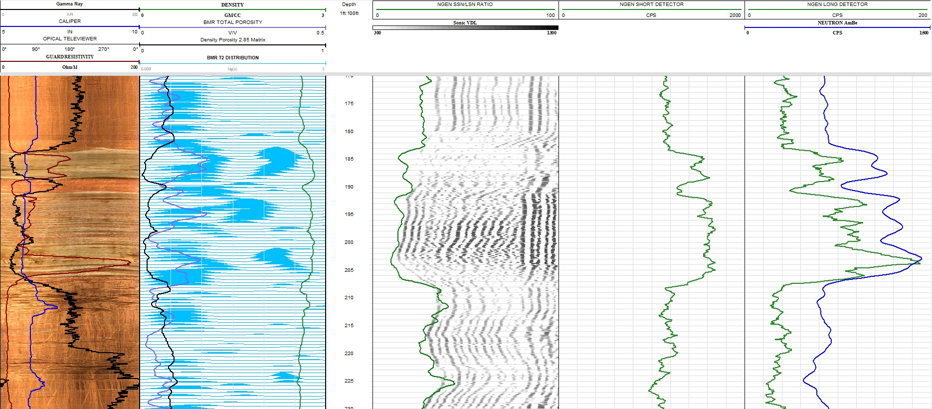
Compare nGen, BMR, AmBe Porosity
Notes:
Comparison of BMR porosity, AmBe porosity, and nGen porosity.
Track 1: Optical Televiewer, gamma (black), caliper (blue), Focused Resistivity (red)
Track 2: BMR T2 distribution (blue waveforms), BMR total porosity (blue log), Density Porosity 2.8 gm/cc matrix (black), green (density)
Track 3: FWS VDL with nGen Short/Long detector ratio
Track 4: Short-spaced nGen CPS
Track 5: AmBe CPS (blue), Long-Spaced AmBe Neutron (CPS)

Slide 28
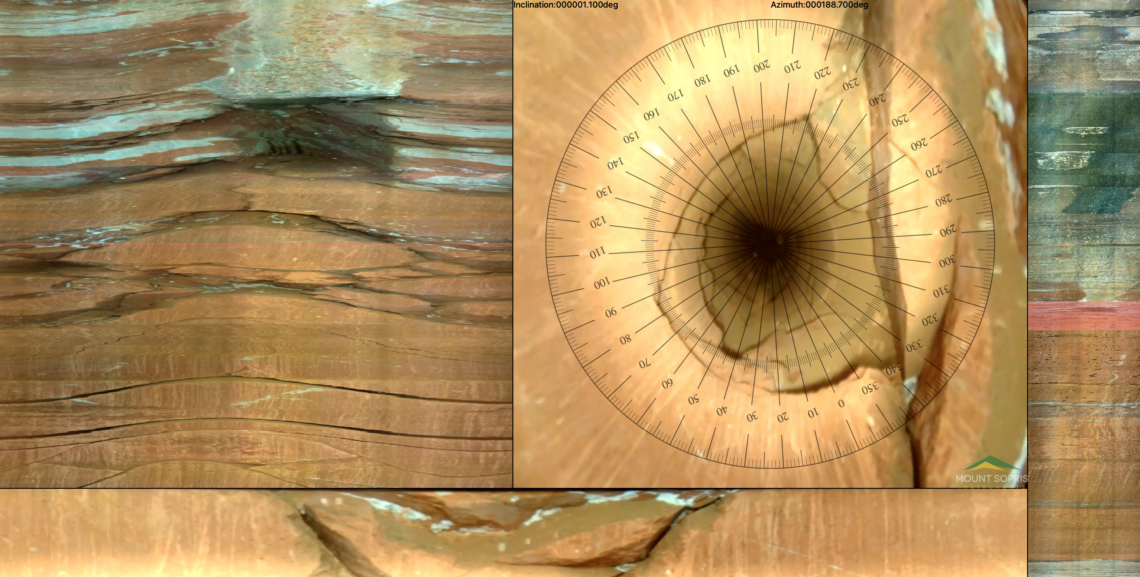
New Generation Borehole Video
Notes:
New generation borehole video cameras now can display on screen compass

Slide 29
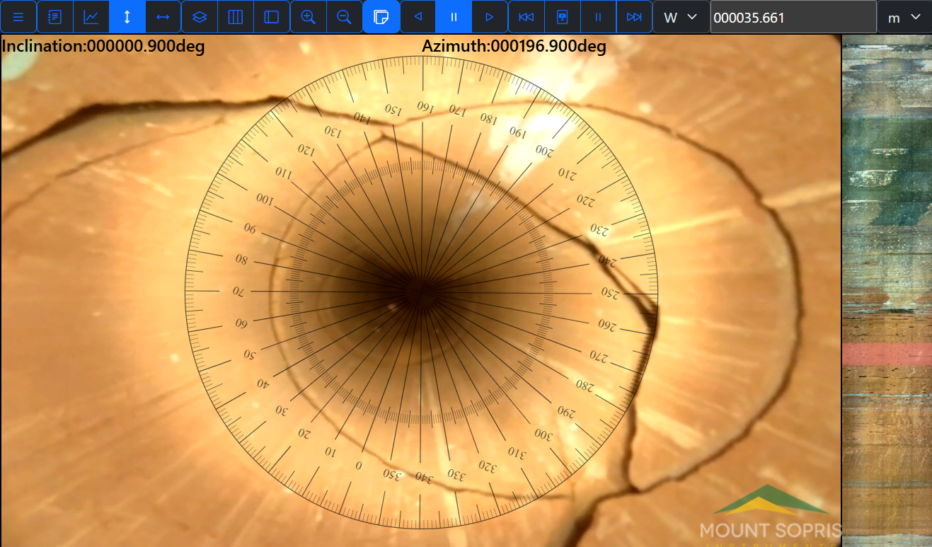
New Generation Borehole Video
Notes:
New generation borehole video cameras now can display on screen compass, digital pan, tilt, zoom, and stabilization.

Slide 30
Future Considerations …
Future Development of Geophysical Logging Tools… ?
Calibrating D-D nGen tool in hydrogeological setting
Better in-situ mineralogy characterization
Higher resolution spectral gamma crystals
Improvements in Downhole XRF
In-situ movement of fluids through rock
Azimuthal borehole radar measurements
Acoustic Televiewer modelling in PVC monitor wells
Non-destructive highway construction pile logging tools.

Slide 31
Colorado USA
Questions ?

